Slide 1
Looma 2 Motherboard Design Review

Slide 2
Motherboard Components
Previous Design:
5V Buck Circuit
Audio Amplifier
USB Hub
Ethernet
Re-designed:
Surge Stopper
19.5V Boost Circuit
Added Fan Control

Slide 3
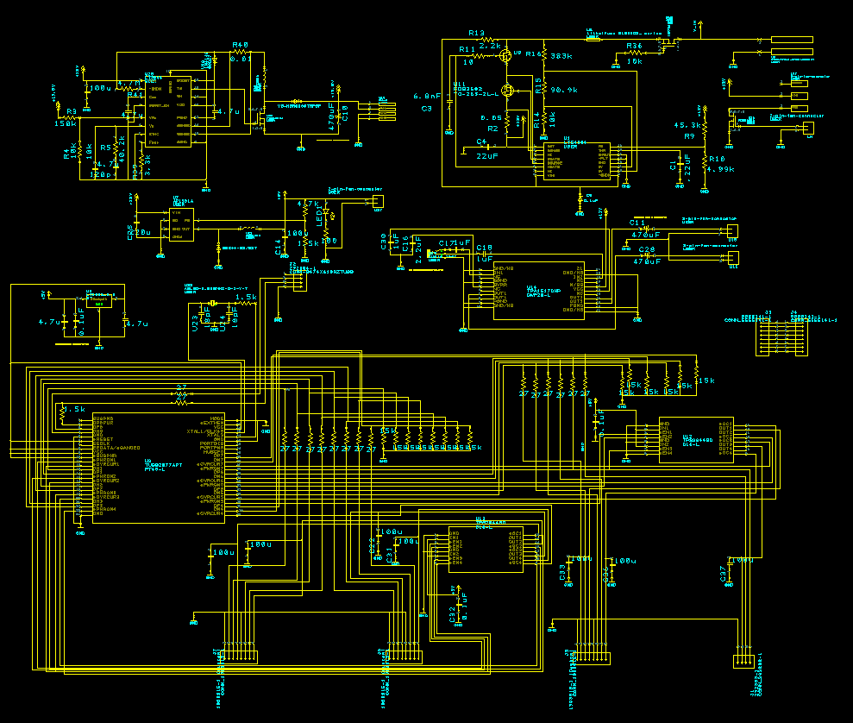

Slide 4
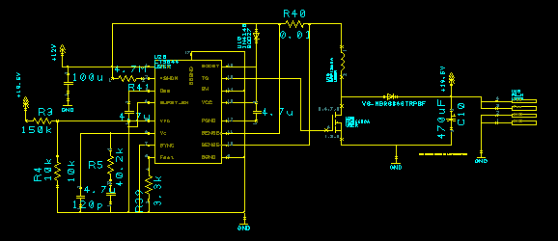
Surge Protector

Slide 5
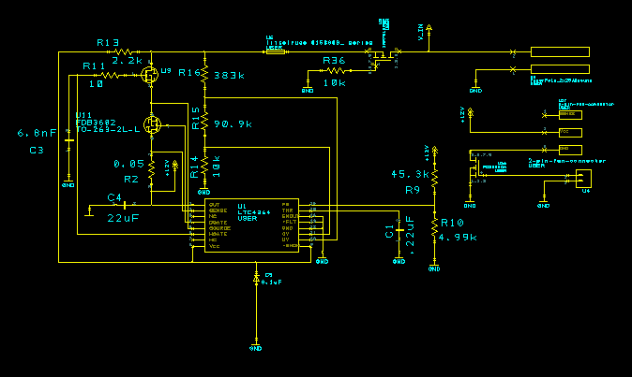
Boost Circuit Protector

Slide 6
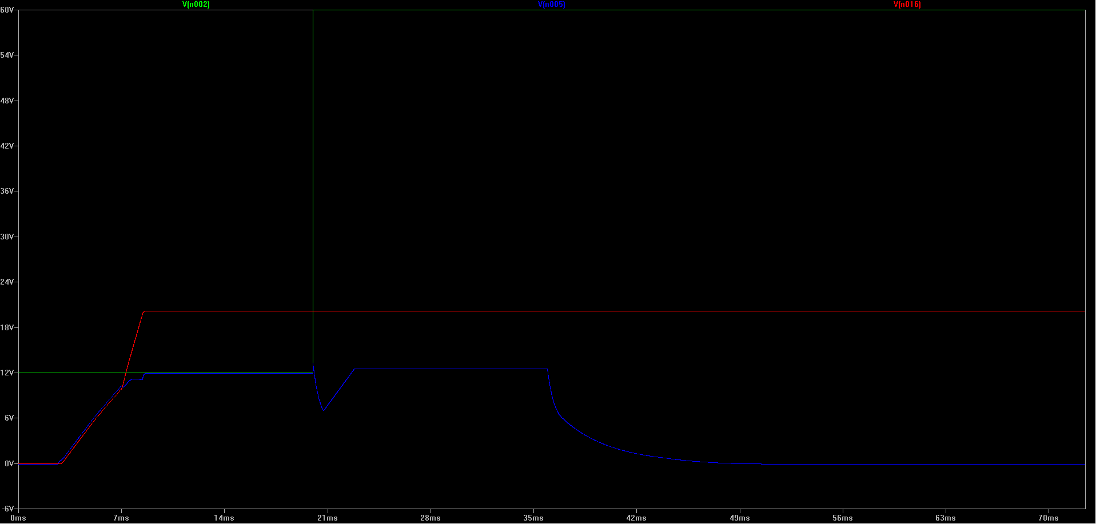
Surge Protector Input
Boost Circuit + Surge Protector without Load
Boost Circuit Output = 19.68 V
Surge Protector Output = Boost Circuit Input
Notes:
No load

Slide 7
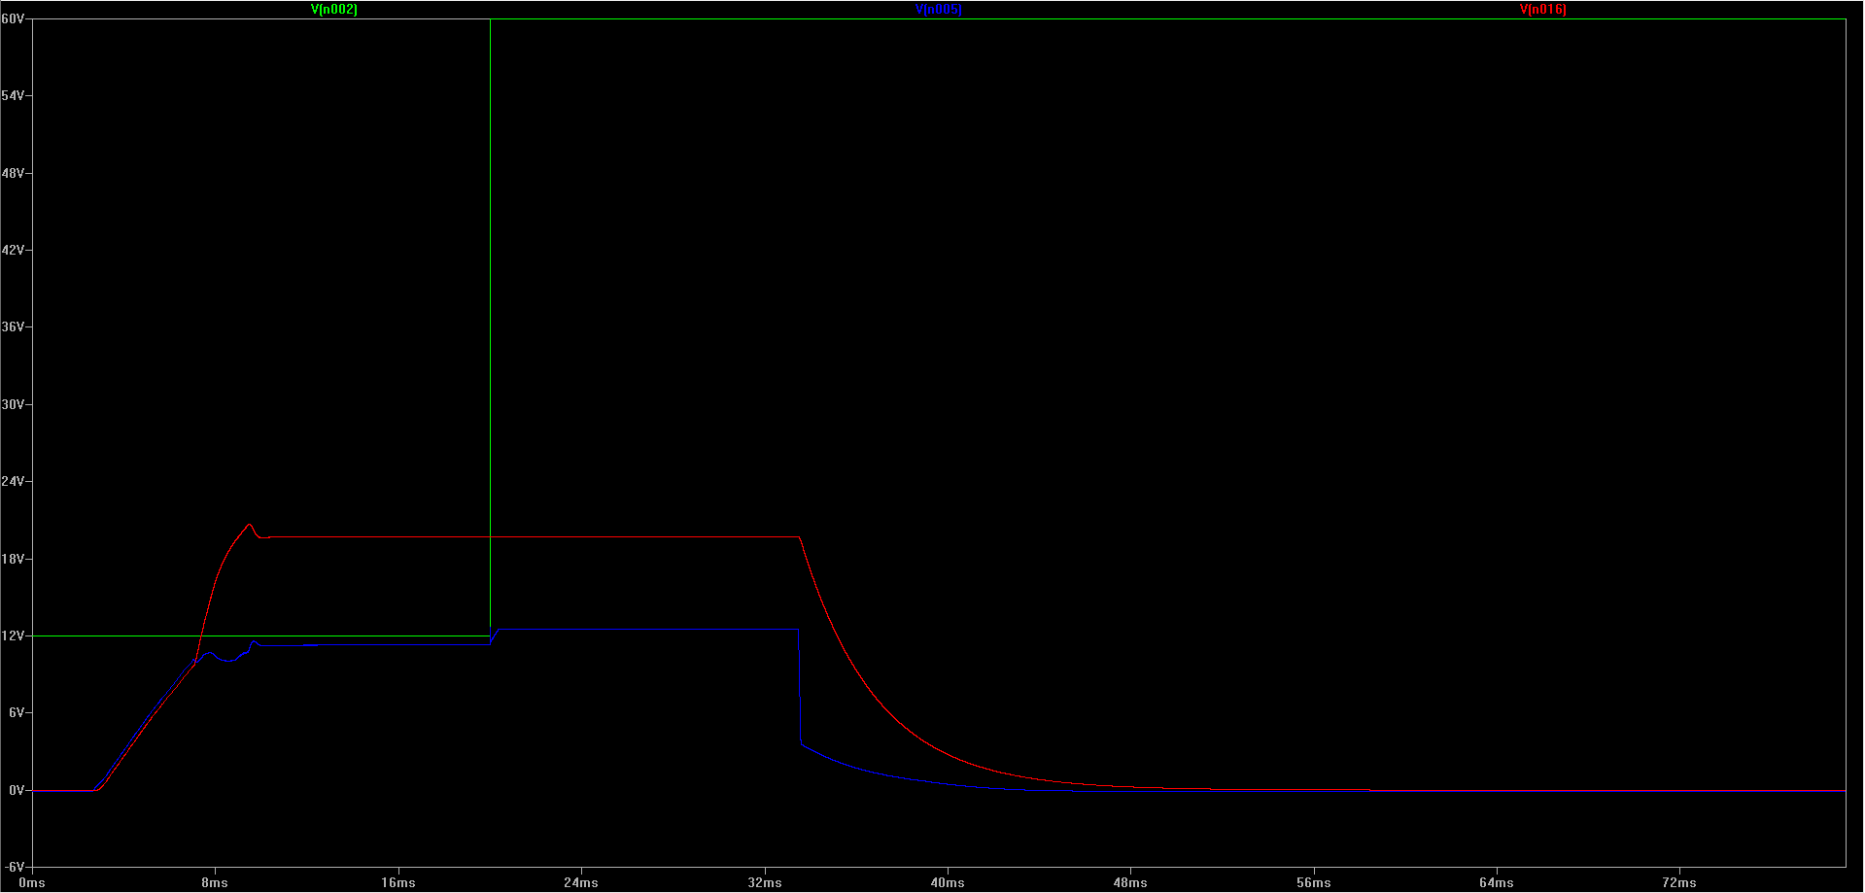
Surge Protector Input
Boost Circuit + Surge Protector with Load
Boost Circuit Output = 19.68 V
Surge Protector Output = Boost Circuit Input
Notes:
Load

Slide 8
